Slide 1
CRC Cards
By Harry Channon, Rory Irwin, Thomas Richards, James Moran & Malte Abmeier

Slide 2
Introduction - Harry
CRC cards – what are they?
How they are used in project management scenarios
Benefits of using crc cards
Positives & negatives

Slide 3
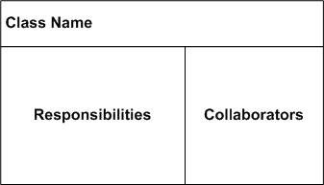
What are CRC cards - Harry
CRC – Class, Responsibility, Collaboration
Class – at the top of the card
Responsibility – to the left of the card
Collaboration – to the right of the card
http://agilemodeling.com/artifacts/crcModel.htm
Notes:
Class – a group of similar objects; can be an object, person or even a place. Used as a singular name, as classes represent a large collective of singular objects
Responsibility – anythign the class knows or does. Actions it can take, information it has.
Collaborators – other cards that this card interacts with.

Slide 4
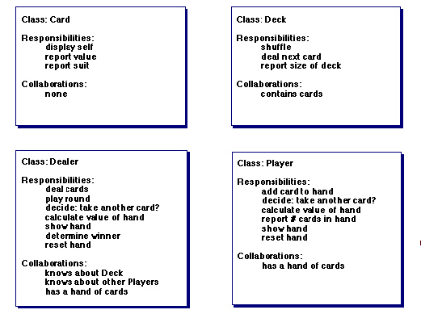
How CRC cards work - Harry
Notes:
Example: how a game of poker would work via crc cards.
Each card has responsibilities and interact through each other via collaborators (excluding the card card)

Slide 5
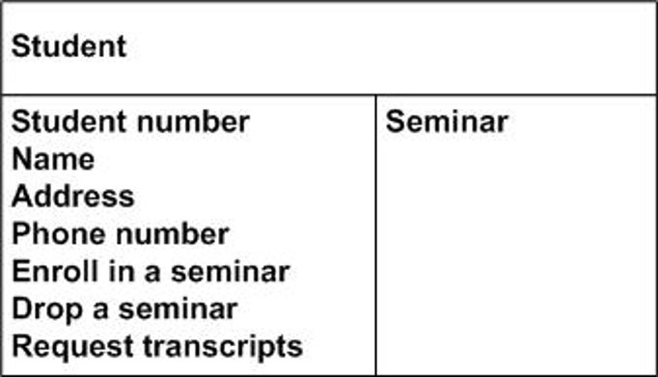
Pro's – Rory
Great for early stages of development.
Easy to make. (can be hand written)
Provide base for future diagrams.
Leaves freedom for designing details later.

Slide 6
COn's - Rory
Lack of detail.
Bad for larger Projects.
Not great on their own.
No sequence of events.

Slide 7
The Benefits of Crc cards as a mechanism for assigning responsibilities - James
Facilitation of open discussion on the static structure of a system
Built-in heuristics that guide design aspects
Enable open discussion of dynamic structure
(Robert Biddle et al, 2002)

Slide 8
The drawbacks of using CRc cards as a mechanism for assigning responsibilities – James
Possibility of Low Cohesion and High coupling
Macho Classes
No clear role is defined
(Mohamed Fayad et al, 2003)

Slide 9
How does it work with agile development? - Tom
Agile development is all about iteration, CRC cards fit this perfectly
Having something physical allows you to visualise links between classes
The simple layout allows people quickly understand what's going on
They allow for foreshadowing of potential issues
Can be used as a base for a UML diagram

Slide 10
Does it always work with agile development? - Tom
While at first it might, they are hard to maintain over many iterations
But yeah, other than that, it does work...

Slide 11
Sources
http://www.informit.com/articles/article.aspx?p=1391208
http://agilemodeling.com/artifacts/crcModel.htm
https://www.youtube.com/watch?v=Bxgn6qJ-bYY

